Slide 1
MODULE 1
Introduction to Natural
Language Processing
Pipeline & Levels of Analysis · Ambiguity & Challenges · Applications · Tools (NLTK / spaCy / HuggingFace)
Shirin Matwankar
Fr. C. Rodrigues Institute of Technology, Vashi | BE Sem VII

Slide 2
Note: The problems have been solved in the notebook. Please refer to it.

Slide 3
OVERVIEW
Module 1 — Roadmap
1.1
NLP Pipeline and Levels of Analysis: Stages in NLP processing-text preprocessing
Theory + Demo
1.2
Ambiguity & Challenges (English + Indian Languages)
Theory + Demo
1.3
Applications of NLP
Theory
1.4
Tools: NLTK · spaCy · HuggingFace
Theory + Demo
M
Math Seeds: Probability · Vectors · Evaluation
Math
CIA
Think-Pair-Share Activity
Assessment
CEPEC7032 — NLP | Module 1: Introduction to NLP
2

Slide 4
1.1 NLP Pipeline and Levels of Analysis: Stages in NLP processing-text preprocessing
THEORY
What is NLP?
Natural Language Processing (NLP) is the branch of AI that enables machines to read, understand, and generate human language.
📖
🧠
✍️
Read
Understand
Generate
Parse raw text into structured form
Extract meaning, intent, and context
Produce fluent, coherent language
Key question: Why is this hard? Because human language is ambiguous, context-dependent, and constantly evolving.
CEPEC7032 — NLP | Module 1: Introduction to NLP
3

Slide 5
Definitions of Natural language processing
Natural Language Processing (NLP) is the ability to process and harness information from a large corpus of text with very little manual intervention.
Natural Language Processing (NLP) is a subfield of linguistics, computer science, and artificial intelligence concerned with the interactions between computers and human language, in particular how to program computers to process and analyze large amounts of natural language data.
Natural Language Processing (NLP) is a field of artificial intelligence (AI) that enables computers to analyze and understand human language, both written and spoken.
CEPEC7032 — NLP | Module 1: Introduction to NLP

Slide 6
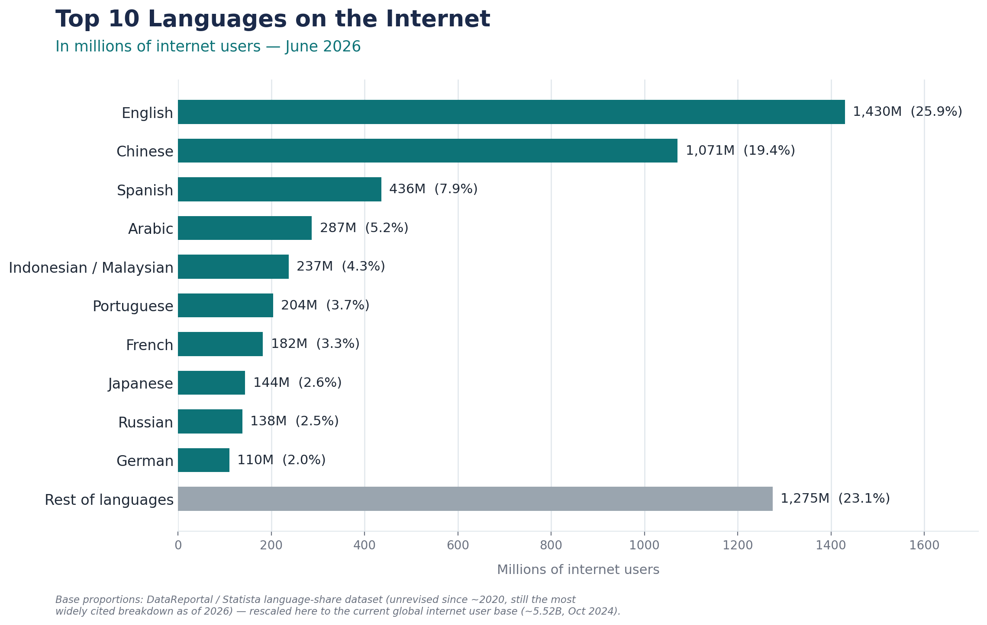
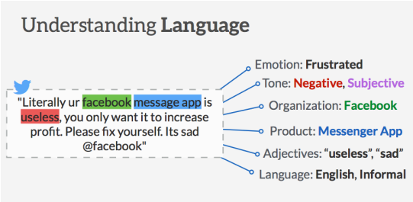
Why study NLP?
Text is the largest repository of human knowledge
News article, web pages, scientific articles, patents, emails, government documents, Wikipedia articles, tweets, posts, comments.
Different types of languages
Mostly data is in unstructured form.
Context of a word in any given language.
CEPEC7032 — NLP | Module 1: Introduction to NLP
Top 10 languages in the Internet in millions of users-June 2026

Slide 7
What is NLP
Fundamental and scientific goal
Deep understanding of broad language and the way language operates.
Engineering goal
Design, implement and test systems that process natural languages for practical implementations.
CEPEC7032 — NLP | Module 1: Introduction to NLP

Slide 8
1.1 NLP PIPELINE & LEVELS OF ANALYSIS
THEORY
Two Components of NLP
NLU
Natural Language Understanding
NLG
Natural Language Generation
▸ Extract concepts & entities
▸ Text planning from a knowledge base
▸ Identify emotions & relations
▸ Sentence planning & word choice
▸ Map input → meaning representation
▸ Set tone and structure
▸ Disambiguate words in context
▸ Surface realization → fluent text
Example: reading a patient record
Example: writing a discharge summary
Module 1: Introduction to NLP
4

Slide 9
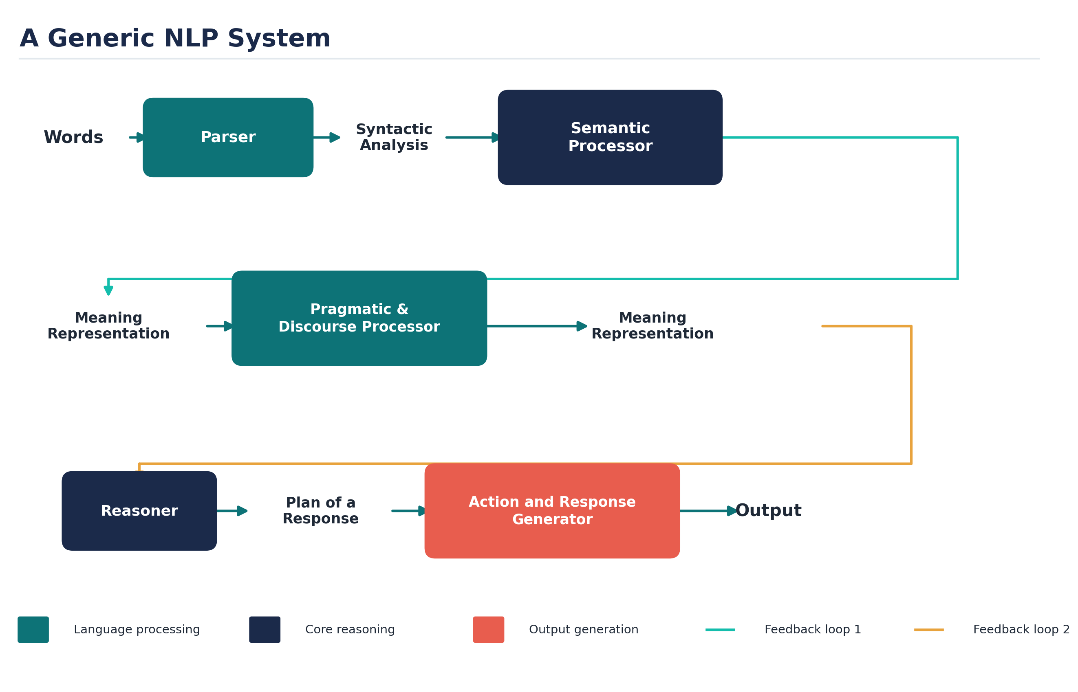
Module 1: Introduction to NLP

Slide 10
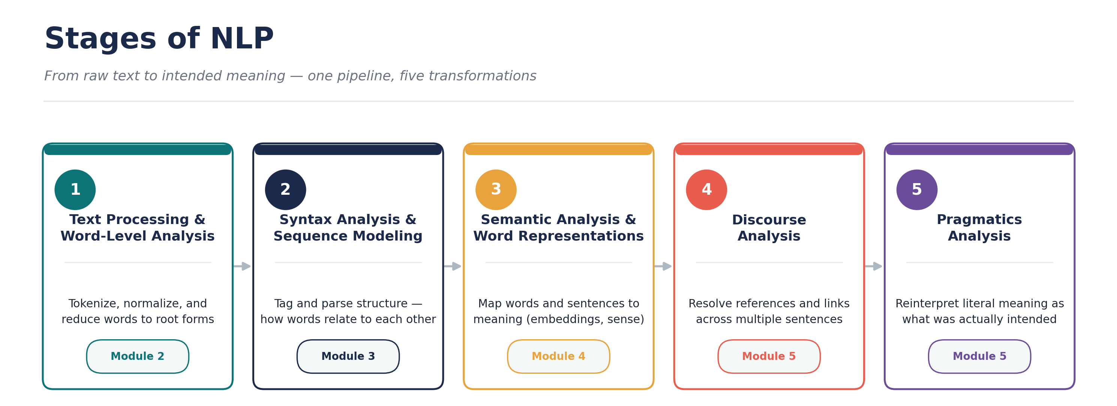
1.1 NLP PIPELINE & LEVELS OF ANALYSIS
THEORY
Each stage exists because the previous stage's output is insufficient alone.
1
2
3
4
5
6
Preprocessing
Morphological
Syntactic
Semantic
Pragmatic
Application
What are the basic units?
What is the base form?
How do words relate?
What does it mean?
What was intended?
What do we do with it?
⚠ Pipeline errors cascade: if tokenization fails, everything downstream fails. Modern transformers (BERT, GPT) learn all stages together — but they are black boxes, harder to debug.
Module 1: Introduction to NLP
5

Slide 11
1.1 NLP PIPELINE & LEVELS OF ANALYSIS
THEORY
Levels vs. Stages — Two Different Things
Same seven categories underneath — but they answer different questions. Levels describe language itself. Stages describe what a system executes.
LEVELS
Linguistic Theory
STAGES
Engineering Pipeline
What kind of knowledge is this?
What do I run, in what order?
▸ Categories a linguist would describe — no computer required
▸ Steps a program actually executes, in sequence
▸ Pure description of language structure
▸ Each stage names a real technique / algorithm
▸ Exists independent of any tool or algorithm
▸ Output of one stage feeds the next
▸ The "grammar of grammar"
▸ The "assembly line" that builds an NLP system
Module 1: Introduction to NLP
6

Slide 12
1.1 NLP PIPELINE & LEVELS OF ANALYSIS
THEORY
Levels vs. Stages — Mapped Side by Side
Level (theory)
Stage (pipeline)
Algorithms / Tools Used
Phonological
1. Preprocessing
Regex, tokenizers, sentence breaking
Morphological
2. Morphological processing
Porter Stemmer, Lemmatization, FST parsing
Lexical
3. Lexical / statistical modeling
N-grams, Laplace smoothing, Good-Turing, Perplexity
Syntactic
4. Syntactic processing
HMM Viterbi, MaxEnt, CRF, CYK, PCFG, Earley Parser
Semantic
5. Semantic processing
Lesk's algorithm, Naïve Bayes WSD, Yarowsky, WordNet
Discourse + Pragmatic
6. Discourse & pragmatic processing
Hobbs algorithm, Centering algorithm (anaphora)
— (application)
7. Application
Sentiment analysis, MT, QA, chatbots
One-line distinction: Levels answer "what kind of knowledge is this?" — Stages answer "what do I run, and in what order?"
Module 1: Introduction to NLP
7

Slide 13
Stages of NLP
Phonetics and phonology
Morphology/ Word level analysis
Lexical Analysis
Syntactic Analysis
Semantic Analysis
Pragmatics
Discourse

Slide 14
Phonetics
Processing of speech
Challenges
Homophones: bank (finance) vs. bank (river bank)
Near Homophones: maatraa vs. maatra (hin)
Word Boundary
aajaayenge (aa jaayenge (will come) or aaj aayenge (will come today)
I got [ua]plate
Phrase boundary
mtech1 students are especially exhorted to attend as such seminars are integral to one's post-graduate education
Disfluency: ah, um, ahem etc.

Slide 15
Lexical Analysis and Morphological
The first phase of NLP is the Lexical Analysis.
It involves identifying and analysing the structure of words.
Lexicon of a language means the collection of words and phrases in a language.
This phase scans the source code as a stream of characters and converts it into meaningful lexemes.
It divides the whole text into paragraphs, sentences, and words.

Slide 16
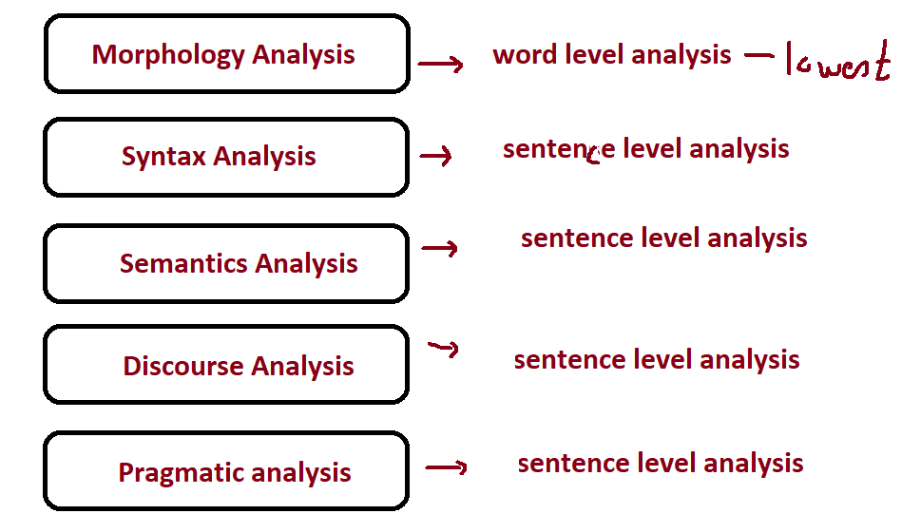

Slide 17
Morphology
Word formation rules from root words
Nouns: Plural (boy-boys); Gender marking (czar-czarina)
Verbs: Tense (stretch-stretched); Aspect (e.g. perfective sit-had sat); Modality (e.g. request khaanaa→ khaaiie)
First crucial first step in NLP
Languages rich in morphology: e.g., Dravidian, Hungarian, Turkish
Languages poor in morphology: Chinese, English
Languages with rich morphology have the advantage of easier processing at higher stages of processing
A task of interest to computer science: Finite State Machines for Word Morphology

Slide 18
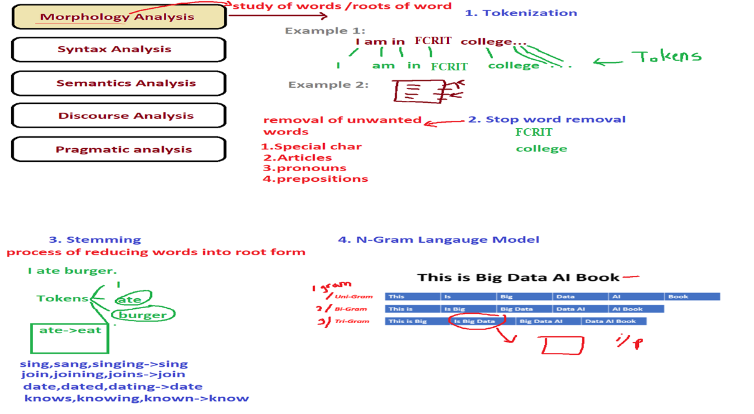

Slide 19
Morphology
Breaking the word and obtaining suffix, features contained in word.

Slide 20
Lexical Analysis
Essentially refers to dictionary access and obtaining the properties of the word
e.g. dog
noun (lexical property)
take-’s’-in-plural (morph property)
animate (semantic property)
4-legged (-do-)
carnivore (-do)
Challenge: Lexical or word sense disambiguation

Slide 21
Lexical Disambiguation
A word follows one sense per discourse
First step: part of Speech Disambiguation
Dog as a noun (animal)
Dog as a verb (to pursue)
Sense Disambiguation
Dog (as animal)
Dog (as a very detestable person)
Needs word relationships in a context
The chair emphasized the need for formal education
Satellite Channel Ad: Watch what you want, when you want (two senses of watch)
Ground breaking ceremony/research

Slide 22
Technological developments bring in new terms, additional meanings/nuances for existing terms
Justify as in justify the right margin (word processing context)
Xeroxed: a new verb
Digital Trace: a new expression
Communifaking: pretending to talk on mobile when you are actually not
Discomgooglation: anxiety/discomfort at not being able to access internet
Helicopter Parenting: over parenting
Plane LI- FI
Crowdturfing
TYPO-TEXTO,SPEAKO
***We add new words or existing words get new meaning.

Slide 23
Syntactic Analysis (Parsing)
Syntactic Analysis is used to check grammar, word arrangements, and shows the relationship among the words.
Deals with analysing the words of a sentence so as to uncover the grammatical structure of the sentence.
E.g.. "Colourless green idea."
This would be rejected by the Syntactic analysis as colourless here; green doesn't make any sense.
Syntactic parsing involves the analysis of words in the sentence for grammar and their arrangement in a manner that shows the relationships among the words.

Slide 24
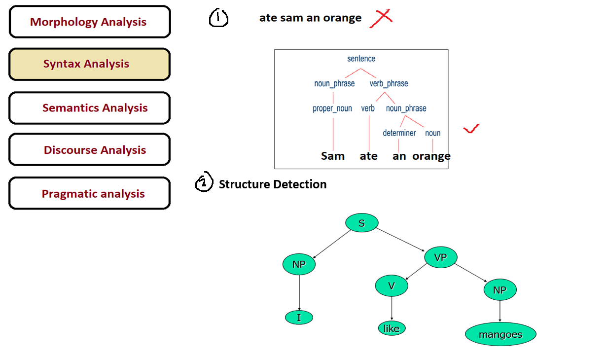

Slide 25
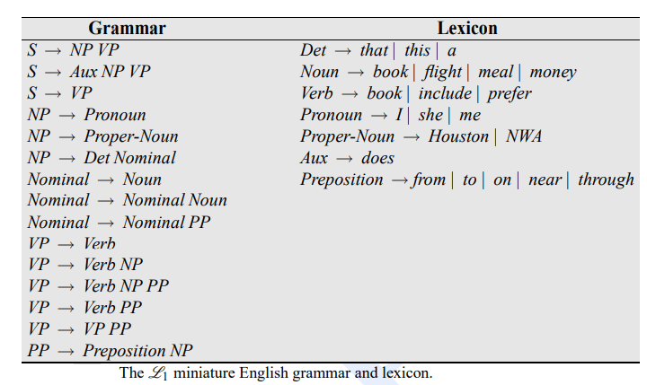
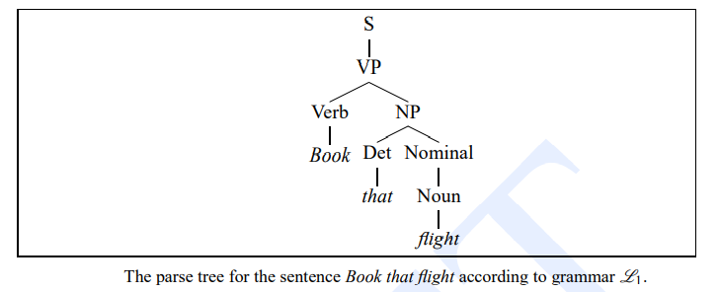

Slide 26
Challenges in Syntactic Processing: Structural Ambiguity
Scope
1.The old men and women were taken to safe locations
(old men and women) vs. ((old men) and women)
2. No smoking areas will allow Hookas inside
Preposition Phrase Attachment
I saw the boy with a telescope
(who has the telescope?)
Very ubiquitous: newspaper headline “20 years later, BMC pays father 20 lakhs for causing son’s death”

Slide 27
Structural Ambiguity
An actual sentence in the newspaper
The camera man shot the man with the gun when he was near Tendulkar
(P.G. Wodehouse, Ring in Jeeves) Jill had rubbed ointment on Mike the Irish Terrier, taken a look at the goldfish belonging to the cook, which had caused anxiety in the kitchen by refusing its ant’s eggs…
(Times of India, 26/2/08) Aid for kins of cops killed in terrorist attacks

Slide 28
Semantic Analysis
Semantic analysis is concerned with the meaning representation.
It mainly focuses on the literal meaning of words, phrases, and sentences.
Determines the possible meanings of a sentence by focusing on the interactions among word-level meanings in the sentence.
Knowledge representation in terms of: Predicate calculus/Semantic nets/ Frames/ Conceptual dependencies and scripts

Slide 29
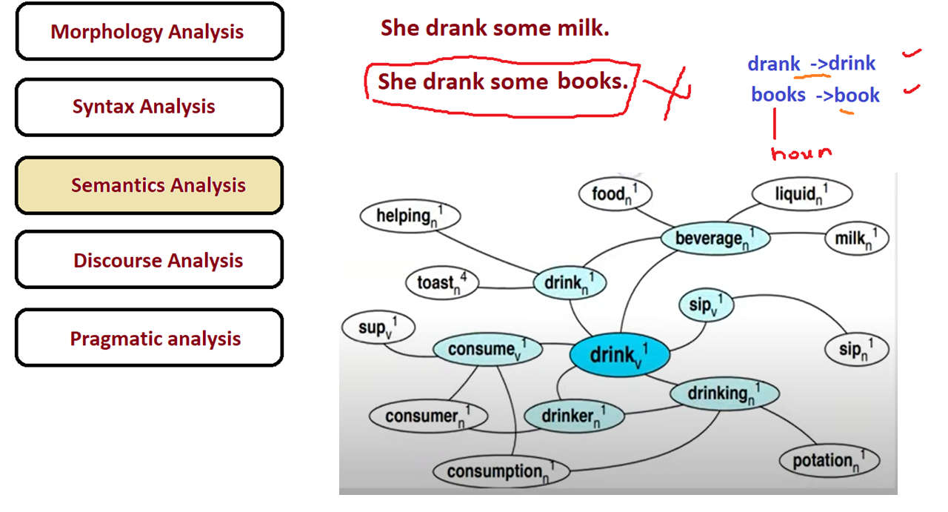

Slide 30
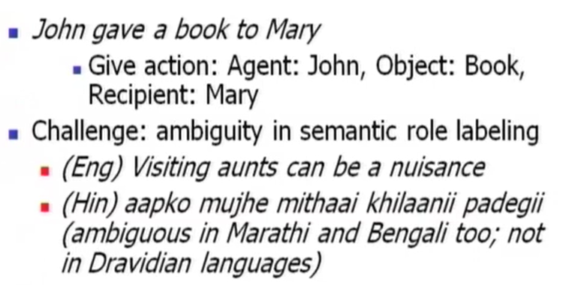

Slide 31
Discourse Integration
Discourse Integration depends upon the sentences that proceeds it and
also invokes the meaning of the sentences that follow it.
Focuses on the properties of the text as a whole that convey meaning by
making connections between component sentences.

Slide 32
It means a sense of the context.
The meaning of any single sentence which depends upon that sentences.
It also considers the meaning of the following sentence.
For example, the word "that" in the sentence "He wanted that" depends upon the prior discourse context.

Slide 33
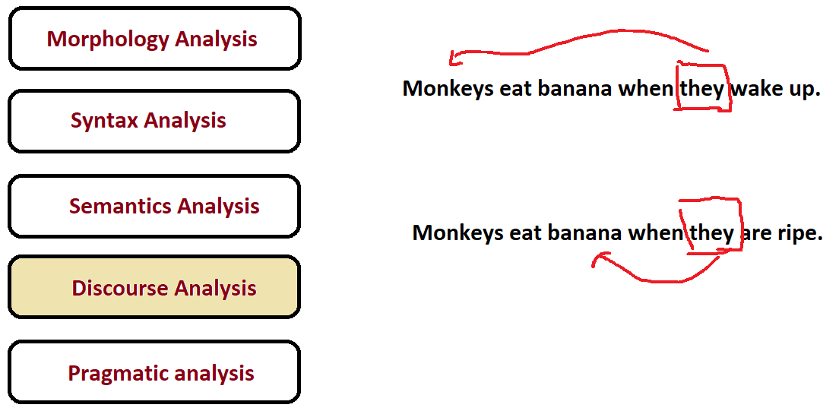

Slide 34
Pragmatic Analysis
Explains how extra meaning is read into texts without actually being encoded in them.
This requires much world knowledge, including the understanding of intentions, plans, and goals.
Consider the following two sentences:
The city police refused the demonstrators a permit because they feared violence.
The city police refused the demonstrators a permit because they advocated revolution.

Slide 35
The meaning of “they” in the 2 sentences is different.
In order to figure out the difference, world knowledge in knowledge bases and inference modules should be utilized.
Pragmatic analysis helps users to discover this intended effect by applying a set of rules that characterize cooperative dialogues.
E.g., "close the window?" should be interpreted as a request instead of an order.

Slide 36
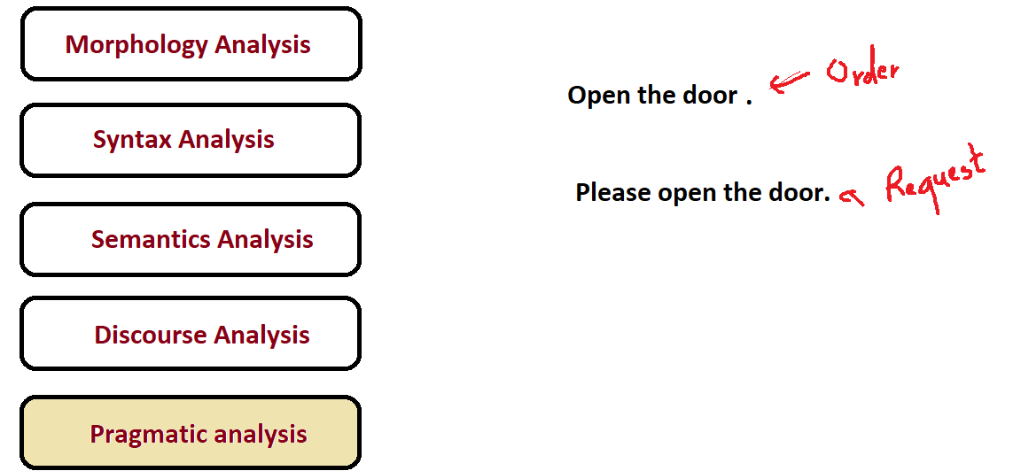

Slide 37
Knowledge in language processing
Engaging in complex language behavior requires various kinds of knowledge of language:
Phonetics and Phonology — knowledge about linguistic sounds
• Morphology — knowledge of the meaningful components of words
• Syntax — knowledge of the structural relationships between words
• Semantics — knowledge of meaning
• Pragmatics — knowledge of the relationship of meaning to the goals and intentions of the speaker.
• Discourse — knowledge about linguistic units larger than a single utterance

Slide 38
1.1 NLP PIPELINE & LEVELS OF ANALYSIS
EXAMPLE
Pipeline in Action — One Sentence, Six Stages
"The banks near the river are closed today."
Preprocessing
["The","banks","near","the","river","are","closed","today","."]
Morphological
bank+s (plural noun) | close+d (past participle)
Syntactic
Subject: "The banks" | Verb: "are closed" | Modifier: "near the river"
Semantic
"banks" = financial institution OR river bank? → Ambiguous without context
Pragmatic
Is this an announcement? A warning? Depends on who is speaking and to whom.
Application
Sentiment → Negative ("closed") | NER → "river" = Location
Module 1: Introduction to NLP
8

Slide 39
1.1 NLP PIPELINE & LEVELS OF ANALYSIS
DEMO
Pipeline Demo — Colab Notebook 1
import nltk, spacy
from transformers import pipeline as hf_pipeline
text = "The banks near the river are closed today."
# Stage 1: Preprocessing — Tokenization
tokens = nltk.word_tokenize(text)
print('Tokens:', tokens)
# Stage 3: Syntactic — POS Tagging + Dependencies
nlp = spacy.load('en_core_web_sm')
doc = nlp(text)
for token in doc:
print(token.text, token.pos_, token.dep_)
# Stage 6: Application — Sentiment
sentiment = hf_pipeline('sentiment-analysis')
print(sentiment(text))
▶ Run on Google Colab — observe each stage's output on the same sentence
Module 1: Introduction to NLP
9

Slide 40
1.1 NLP PIPELINE & LEVELS OF ANALYSIS
DISCUSS
Pipeline — Discuss
?
Can we skip Syntactic and go straight to Semantic?
→ Modern transformers do — but they learn syntax implicitly. Classical systems couldn't. Black box vs. interpretable.
?
What happens if Tokenization fails?
→ Everything downstream fails. Pipeline errors cascade — the biggest risk in production NLP systems.
?
Where is the full pipeline used right now?
→ Google Search · Resume screeners · Legal document analysis · Gmail Smart Reply · Alexa/Siri
?
Alternative to pipeline architecture?
→ End-to-end neural models (BERT, GPT-4) — learn all stages together. Higher accuracy, harder to debug, needs massive data.
Module 1: Introduction to NLP
10

Slide 41
1.2 AMBIGUITY & CHALLENGES
THEORY
Types of Ambiguity — Why NLP is Hard
Humans resolve ambiguity effortlessly using context, world knowledge, and intent. Machines have none of these by default.
Lexical
Syntactic
Semantic
Pragmatic
Anaphoric
Same word, multiple meanings
Same structure, multiple parse trees
Same sentence, multiple scope readings
Literal meaning ≠ intended meaning
Pronoun with multiple referents
"I went to the bank." → river or financial bank?
"I saw the man with the telescope." → who has it?
"Every student solved a problem." → same or different?
"Can you pass the salt?" → a request, not a question
"Margaret invited Susan. She gave her lunch." → who?
Module 1: Introduction to NLP
11

Slide 42
Ambiguities and its types in NLP
Multiple meaning or interpretation of a word, sentence or phrase.
We can say that it is any case where a surface form might have multiple interpretations.
Types of ambiguity:
Lexical ambiguity
Syntactic ambiguity
Semantic ambiguity
Anaphoric ambiguity
Pragmatic ambiguity

Slide 43
Morphological/Lexical/word category ambiguity
Ambiguity of a single word is called as lexical ambiguity.

Slide 44
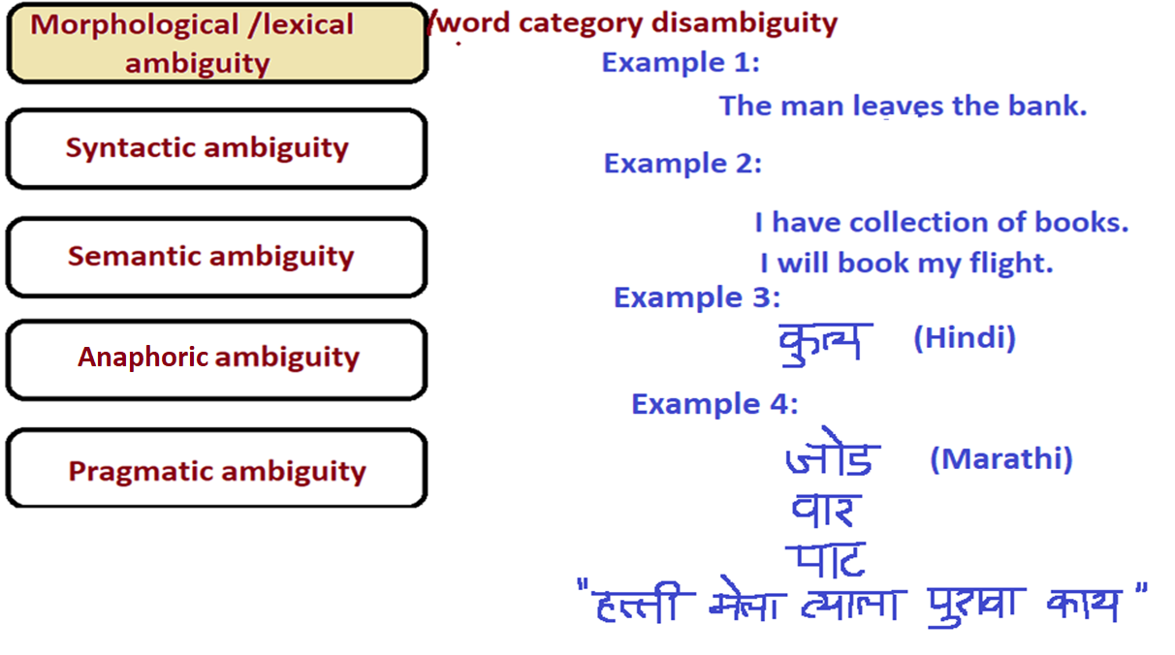

Slide 45
Lexical Disambiguation
First step: part of Speech Disambiguation
Dog as a noun (animal)
Dog as a verb (to pursue)
eg. A shadowy figure was dogging their every move
Sense Disambiguation
Dog (as animal)
Dog (as a very detestable person)
Needs word relationships in a context
The chair emphasized the need for formal education
Satellite Channel Ad: Watch what you want, when you want (two senses of watch)
Ground breaking ceremony/research

Slide 46
Syntactic ambiguity
Syntactic ambiguity occurs when sentence is parsed in different ways.
In this, ambiguity is present in sentence structure. It specifies the possible arrangements of words in given sentence.
If grammar rules are itself ambiguous, then ambiguity will be in sentence structure so handling this ambiguity and finding correct grammar is an important task.
Example :
The man saw the boy with the telescope.
I1: The man saw the boy carrying the telescope.
I2: The man saw the boy through the telescope.

Slide 47
Challenges in Syntactic Processing: Structural Ambiguity
Scope
1.The old men and women were taken to safe locations
(old men and women) vs. ((old men) and women)
2. No smoking areas will allow Hookas inside
Preposition Phrase Attachment
I saw the boy with a telescope
(who has the telescope?)
Very ubiquitous: newspaper headline “20 years later, BMC pays father 20 lakhs for causing son’s death”

Slide 48
Example 2:
Phrase attachment:
"Mary ate a salad with spinach from California for lunch on Tuesday." ->"with spinach" can attach to "salad" or "ate" ->"from California" can attach to "spinach", "salad", or "ate". ->"for lunch" can attach to "California", "spinach", "salad", or "ate" ->"on Tuesday" can attach to "lunch", "California", "spinach", "salad" or "ate". (Crossovers are not allowed, so you cannot both attach "on Tuesday" to "spinach" and attach "for lunch" to “salad”. Nonetheless there are 42 possible different parse trees.)
Example 3:
Conjunction:
"Mary ate a salad with spinach from California for lunch on Tuesday and Wednesday." "Wednesday" can be conjoined with salad, spinach, California, lunch, or Tuesday.

Slide 49
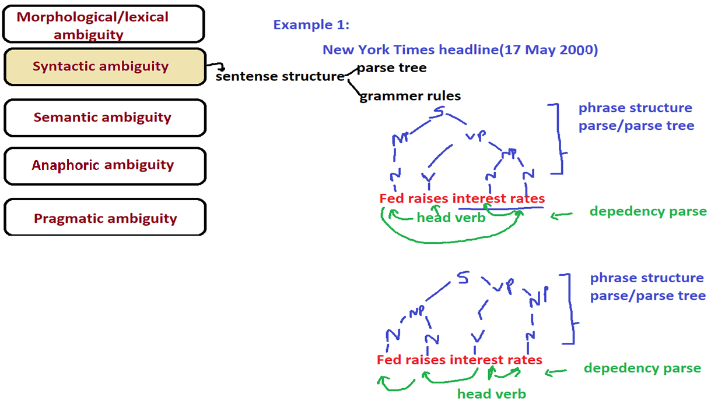

Slide 50
Semantic ambiguity
Even after the syntax and the meanings of the individual words have been resolved, there are two ways of reading the sentence.
Semantic ambiguity occurs when the meaning of the words themselves can be misinterpreted. In other words, semantic ambiguity happens when a sentence contains an ambiguous word or phrase.

Slide 51
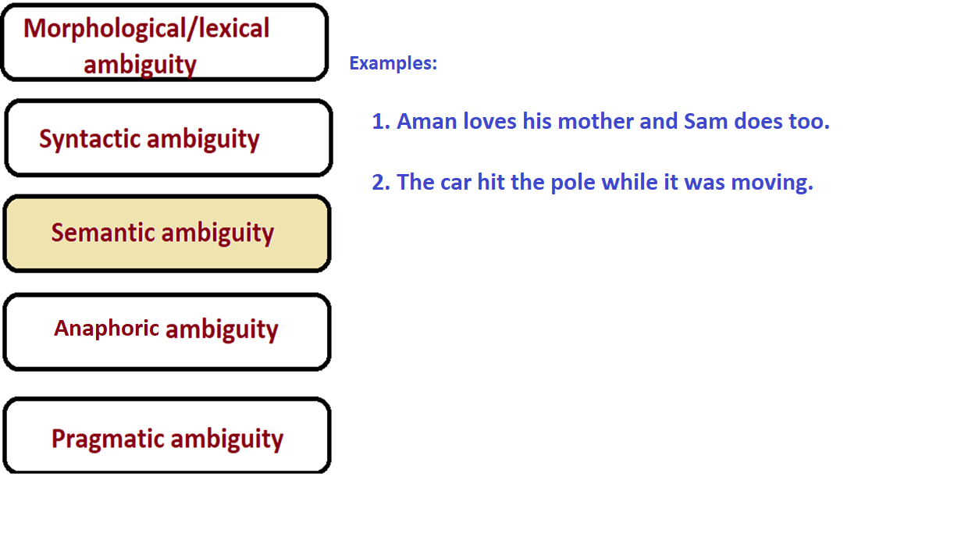

Slide 52
Anaphoric ambiguity
A phrase or word refers to something previously mentioned, but there is more than one possibility.
Examples:
"Margaret invited Susan for a visit, and she gave her a good lunch." (she = Margaret; her = Susan)
"Margaret invited Susan for a visit, but she told her she had to go to work" (she = Susan; her = Margaret.)
"On the train to Boston, George chatted with another passenger. The man turned out to be a professional hockey player." (The man = another passenger).
"I went to the hospital, and they told me to go home and rest." (They = the hospital staff.)

Slide 53
Anaphoric ambiguity
Non-literal speech
"The White House announced today that ..." ("White House" = the President's staff)
"The price of tomatoes in Des Moines has gone through the roof" (= increased greatly) -:Metaphor.
Ellipsis
The omission of words that are needed for grammatical completion, and are "understood".
E.g. "I am allergic to tomatoes. Also fish." Understood as "I am also allergic to fish" rather than "Also, fish are allergic to tomatoes."

Slide 54
Pragmatic ambiguity
Pragmatic ambiguity refers to the situation where the context of a phrase gives it multiple interpretations. In simple words, we can say that pragmatic ambiguity arises when the statement is not specific.

Slide 55
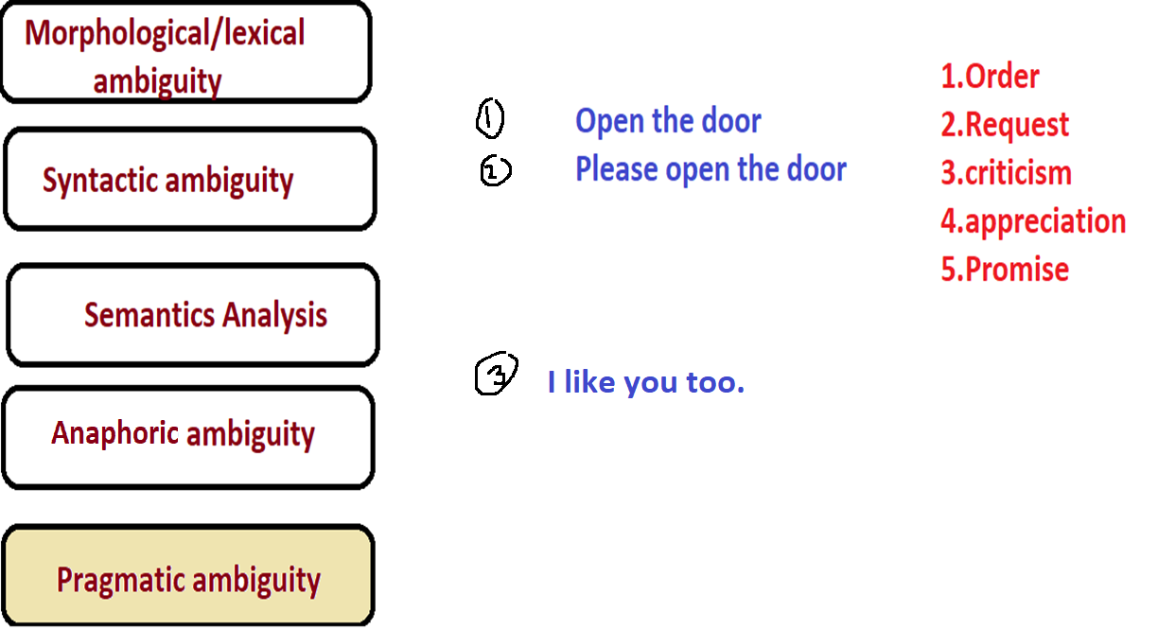

Slide 56
1.2 AMBIGUITY & CHALLENGES
DEMO
Ambiguity Demo — Where SpaCy Succeeds and Fails
import spacy
nlp = spacy.load('en_core_web_sm')
sents = ["I went to the bank to deposit money.",
"I sat by the river bank fishing."]
for sent in sents:
doc = nlp(sent)
for token in doc:
if token.text.lower() == 'bank':
print(sent[:30], '→ POS:', token.pos_,
'| Entity:', token.ent_type_ or 'None')
# Pragmatic failure — sentiment on a polite request
from transformers import pipeline as hf_pipeline
sentiment = hf_pipeline('sentiment-analysis')
print(sentiment('Can you pass the salt?'))
# Output: confident sentiment label (e.g. NEGATIVE, 0.77) despite this being a request, not an opinion — exact label varies by model version
Key observation: SpaCy gets 'bank' right when context is strong, fails when weak. The sentiment model forces a confident positive/negative label onto a request — pragmatics is invisible to it either way.
Module 1: Introduction to NLP
13

Slide 57
1.2 AMBIGUITY & CHALLENGES
THEORY
Challenges: Indian Languages
Most NLP tools are trained on English. Indian languages present fundamentally different challenges.
Morphological richness
Marathi: जातो (going, masc.) vs जाते (going, fem.) — gender encoded in the verb
Free word order
"राम ने सीता को देखा" and "सीता को राम ने देखा" mean the same thing
Code-mixing
"Main kal office gaya and will submit the report" — both languages, one sentence
Script diversity
22 scheduled languages, 12+ scripts — Hindi, Marathi, Tamil, Telugu, Kannada, etc.
Low annotated resources
English: millions of labelled sentences. Marathi: tens of thousands — ~100× less data
Market opportunity: Any NLP product for Indian users must handle these. Most English models fail. → Open research + business gap.
Module 1: Introduction to NLP
14

Slide 58
Challenges in NLP
DATA & AVAILABILITY
Availability of Natural languages
Availability of different sources of data
Unstructured form of data
AMBIGUITY (WORD & PHRASE LEVEL)
Ambiguity
Homophones
Word boundary
Phrase boundary
Part of speech disambiguation
Sense disambiguation
Preposition phrase attachment
Scope: noun, adjectives

Slide 59
Challenges in NLP
VOCABULARY DRIFT
Addition of new words due to technical development
Idioms
Neologisms
WORLD KNOWLEDGE
World knowledge
INFORMAL / NON-STANDARD TEXT
Non standard English words
Segmentation issues
Tricky entity names
Elongated words
Shortcuts
Emojis
Mixed use of languages
Ellipsis
Punctuational ambiguity

Slide 60
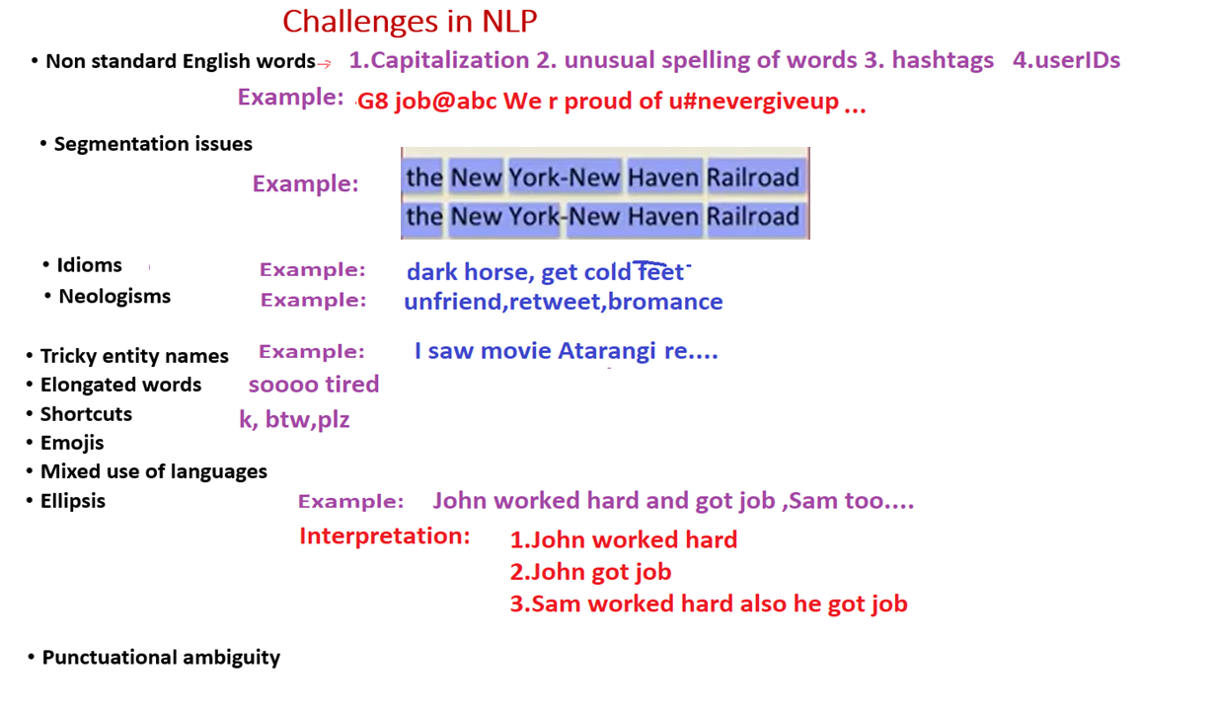

Slide 61
1.2 AMBIGUITY & CHALLENGES
DISCUSS
Ambiguity — Discuss
?
Which ambiguity type is hardest for machines?
→ Pragmatic — requires world knowledge and intent, not just text patterns. Even GPT-4 fails on subtle cases.
?
How do modern LLMs handle ambiguity?
→ Through massive training data — they learn which meaning is statistically more common in context. Pattern matching, not true understanding.
?
Your project domain — what ambiguity will hurt you most?
→ e.g. sentiment analysis → lexical ambiguity; chatbot → pragmatic ambiguity; NER → anaphoric ambiguity.
?
Why does India need its own NLP models?
→ English models miss morphology, code-mixing, and cultural context. IndicBERT, MuRIL, Koo's Indic models are emerging.
Module 1: Introduction to NLP
15

Slide 62
1.3 APPLICATIONS OF NLP
THEORY
Applications — Mapped to Pipeline Stages
Don't memorize applications — understand which pipeline stages each one requires.
Application
Pipeline Stages Required
Real Products
Machine Translation
All 6 stages
Google Translate · DeepL
Sentiment Analysis
Preprocessing + Semantic
Amazon reviews · Twitter analytics
Named Entity Recognition
Morphological + Syntactic + Semantic
Bloomberg · Reuters news wires
Question Answering
All stages + world knowledge
ChatGPT · Google SGE · Bing AI
Text Summarization
Semantic + Pragmatic
Notion AI · Quillbot · Claude
Autocomplete
Morphological + N-gram model
Gmail Smart Compose · Copilot
Module 1: Introduction to NLP
16

Slide 63
1.3 APPLICATIONS OF NLP
THEORY
Why NLP is Booming Right Now
🤗
Pretrained Models
⚡
Open Source Stack
HuggingFace Hub: 500,000+ models. Transfer learning — fine-tune BERT in minutes, not months.
spaCy, NLTK, Gensim, Transformers, LangChain — all free, well-documented, industry-grade.
☁️
Cheap Cloud GPUs
💰
Massive Investment
Colab (free), AWS, Azure, GCP — A100/H100 GPUs on-demand. No hardware barrier.
Major funding across OpenAI, Anthropic, Google DeepMind — NLP is the hottest engineering field.
NLP job roles: Data Scientist · NLP Engineer · NLP Researcher · ML Engineer · Prompt Engineer
Module 1: Introduction to NLP
17

Slide 64
1.3 APPLICATIONS OF NLP
THEORY
Applications — 2026 Snapshot: Enterprise & Healthcare
Where NLP is deployed in production today, and what's changed since your textbook examples.
Application
2026 Update
Why It Matters
Enterprise Search (RAG)
Retrieval-augmented generation is now the dominant enterprise AI architecture
Updates company knowledge without expensive retraining
Customer Service Chatbots
Now handle the majority of customer interactions
Lower cost, higher reported satisfaction
Spam / Phishing Detection
AI filters block 99.9%+ of unwanted mail
Most phishing mail now uses AI-generated text to evade filters — an arms race
Clinical Documentation
Voice-to-text NLP produces structured clinical notes
>95% accuracy on trained data; frees physician time from EHR entry
Module 1: Introduction to NLP
18

Slide 65
1.3 APPLICATIONS OF NLP
THEORY
Technical Trends Shaping NLP (2026)
📱
On-Device / Edge NLP
🤖
Autonomous Language Agents
Compressed models (TinyML) run directly on phones and wearables instead of the cloud — one of the fastest-growing 2026 trends.
Plan and complete multi-step tasks with minimal supervision using memory + tools (LangGraph, AutoGen, CAMEL-AI).
⚙️
Efficient Attention
🕸️
Knowledge Graphs
Linear and sparse attention research (e.g. Linformer) aims to handle much longer contexts without hardware bottlenecks.
Tools like Neo4j and TigerGraph are embedded further into company infrastructure for traceability and logical consistency.
Extends Topic 1.3: enterprise RAG search, ambient clinical documentation, and on-device NLP build on the chatbot / MT / sentiment-analysis examples above
Module 1: Introduction to NLP
19

Slide 66
1.4 TOOLS: NLTK · SPACY · HUGGINGFACE
THEORY
Three Tools — Positioning & Philosophy
These are not competitors — they serve different needs. A real NLP engineer uses all three.
NLTK
spaCy
🤗 HuggingFace
Education-first. Explicit steps. Verbose but transparent.
Speed + accuracy. Industrial grade. Opinionated pipeline.
State of the art. Model hub. Transformer-powered.
✅ Free, 50+ corpora, great for understanding internals
✅ Fast, clean API, production-ready, 65+ languages
✅ 500k+ models, BERT/GPT/T5, highest accuracy
⚠ Slow, verbose, rarely used in production
⚠ Less transparent than NLTK, fewer classical models
⚠ Heavy, needs GPU, can be overkill for simple tasks
Learning & research
Production & industry
Modern deep learning
Module 1: Introduction to NLP
18

Slide 67
1.4 TOOLS: NLTK · SPACY · HUGGINGFACE
DEMO
Tools Demo — Same Task, Three Libraries
text = "Elon Musk founded SpaceX in 2002 in Hawthorne, California."
# TOOL 1: NLTK
import nltk; from nltk.tokenize import word_tokenize
tokens = word_tokenize(text)
ne_tree = nltk.ne_chunk(nltk.pos_tag(tokens))
for chunk in ne_tree:
if hasattr(chunk, "label"): print("NLTK →", chunk)
# TOOL 2: SpaCy
import spacy; nlp = spacy.load("en_core_web_sm")
for ent in nlp(text).ents: print("SpaCy →", ent.text, ent.label_)
# TOOL 3: HuggingFace Transformers
from transformers import pipeline as hf_pipeline
ner = hf_pipeline("ner", aggregation_strategy="simple")
for r in ner(text):
print(f"HF → {r['word']:20} {r['entity_group']} {r['score']:.3f}")
Observe: NLTK misses some entities · SpaCy is fastest · HuggingFace gives confidence scores.
Module 1: Introduction to NLP
19

Slide 68
1.4 TOOLS: NLTK · SPACY · HUGGINGFACE
DISCUSS
Tools — Discuss
?
If HuggingFace is most accurate, why use NLTK?
→ Learning, lightweight tasks, no GPU required, explainability. You can see every step — readable in exam questions.
?
Which tool for Indian languages, e.g. Marathi?
→ Limited: iNLTK (deep learning for Indic), IndicNLP library, Stanza (66+ languages). HuggingFace has IndicBERT, MuRIL.
?
Market reality check
→ HuggingFace = GitHub of AI. spaCy = used in production at Prodigy, Explosion AI. NLTK = taught everywhere, rarely in production.
Module 1: Introduction to NLP
20

Slide 69
MATH SEEDS
MATH
Math Seeds — Foundations for Later Modules
1
Language as Probability
A language model assigns P(sentence) to every possible sentence — machines compute likelihood, not understanding.
P("The cat sat on the mat") = 0.00031 vs. P("Quantum the mat sat cat the") ≈ 0
2
Text as Numbers (Bag of Words)
Vocabulary = ["good","bad","movie"] → "good movie" = [1,0,1]
Simple baseline, but ignores word order. → Module 2: TF-IDF · Module 4: Word2Vec, BERT
3
Evaluation — How Do We Know It Works?
NLP systems are measurable: Accuracy, Perplexity, F1 Score, BLEU/ROUGE.
Every NLP model has an evaluation metric — always ask how we measure success.
Module 1: Introduction to NLP
21

Slide 70
Module 1 — Key Takeaways
Module 1 — Key Takeaways
🔗
Pipeline is a dependency chain — each stage feeds the next. Errors cascade.
❓
Ambiguity (lexical, syntactic, semantic, pragmatic, anaphoric) is the core challenge.
🇮🇳
Indian languages need special treatment — morphology, code-mixing, low resources.
🛠
NLTK = learn · spaCy = produce · HuggingFace = state-of-the-art. Use all three.
📐
Language = probability. Text = vectors. Every model formalizes one of these two ideas.
📊
Every NLP system is measurable. Always ask: how do we know if it's working?
Next: Module 2 — Text Processing & Word-Level Analysis
Module 1: Introduction to NLP
22

Slide 71
Source
Nptel courses(NLP)
Dan Jurafsky (Standford university)
https://web.standford.edu/~jurafsky/NLPCourseraSlides.html
Notes on Ambiguity (nyu.edu)
Natural Language Processing (devopedia.org)

